Slide 1
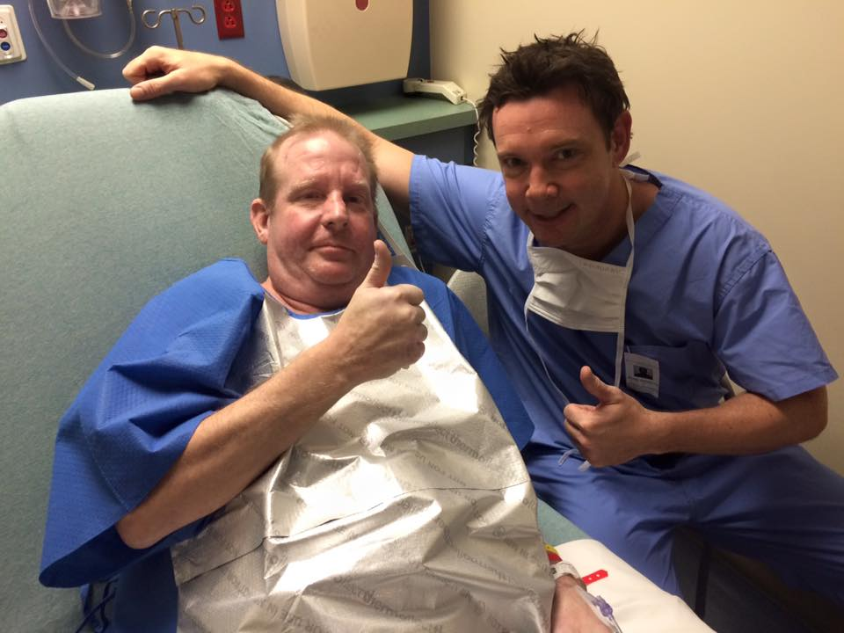
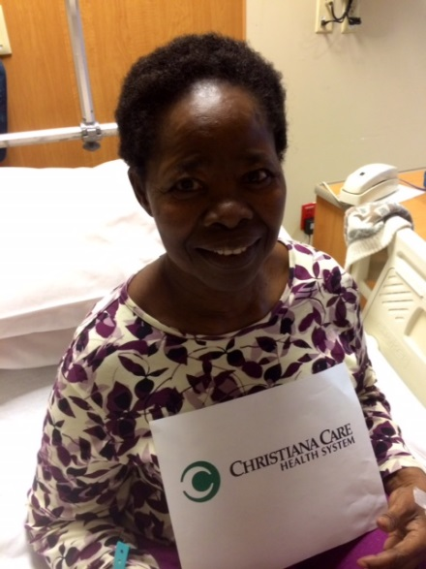
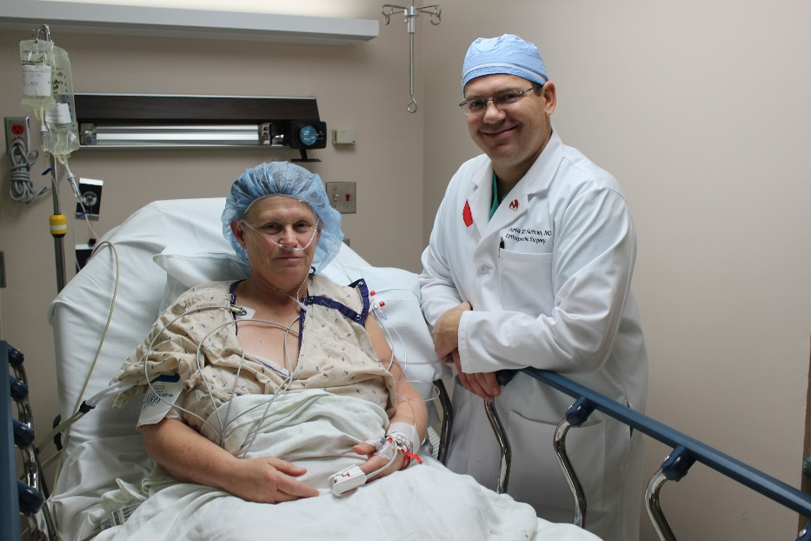
Operation Walk USA
Restoring Mobility. Giving Hope.

Slide 2
What is Operation Walk USA?
Founded and incorporated in 2011 as a 501c3 charity.
A network of volunteers: surgeons, hospitals, healthcare providers across the United States.
Pro bono hip/knee replacement surgeries to uninsured patients in the United States who are:
US citizens or permanent US residents
At or below 300% FPG
Surgeries always take place during the first week of December.
Orthopaedic device industry donates implants.
Headquartered in Schaumburg, IL (management services contracted from/provided by The Hip Society and The Knee Society).

Slide 3
Why Operation Walk USA?
The number of uninsured non-elderly Americans in the first half of 2023 was 25.3M (Source: CDC.gov)
Low-income working families make up over 40% of the remaining uninsured – “the working poor”.
Since 2010, Operation Walk USA has provided $24.6M in pro bono medical services, and treated over 900 patients.
Average annual impact of Operation Walk USA:
STATES | HOSPITALS | SURGEONS | PATIENTS | VALUE
21 | 33 | 55 | 82 | $2.4

Slide 4
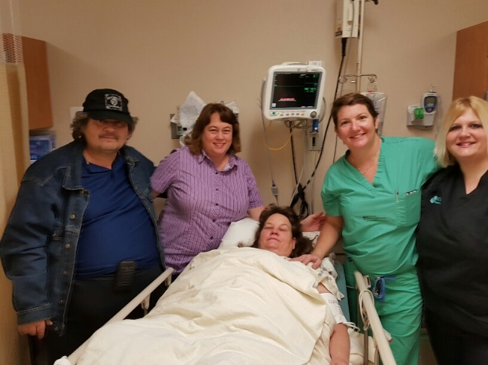
“Faces of Operation Walk USA”
Angela Preiss, 51, Cuero, TX:
Hip trauma due to auto incident
Caring for disabled husband and 2 grandchildren
Had to stop working as a nursing aid due to severe pain
Operated on by Amanda Marshall, MD (San Antonio, TX)
Angela today: “No walker, no more cane. I am getting better and my grandkids are listening and I am able to do more with them. It is wonderful to walk and have no pain.”

Slide 5
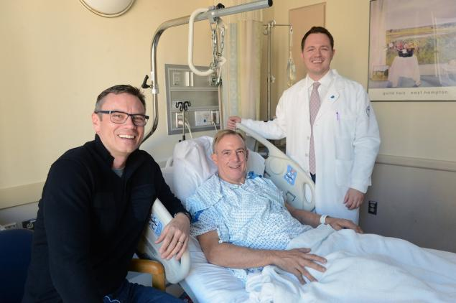
“Faces of Operation Walk USA”
Arthur Shaw, 51, Manapalan, NJ
Former high school athlete, hip getting progressively worse
Insurance cost-prohibitive
Works for a friend’s small business
Operated on by Matthew Hepinstall, MD (New York, NY)
Arthur today: “I am doing just fabulous. I am so glad to be on the other side. I am feeling super and have no pain. I’m active and back to life.”

Slide 6
Answers We Actively Seek
HOW to expand patient acceptance criteria to be able to offer assistance to “underinsured” individuals
HOW to recruit more volunteers in strategic states (that have not expanded Medicaid)
HOW to spread the word and help qualifying patients find us

Slide 7
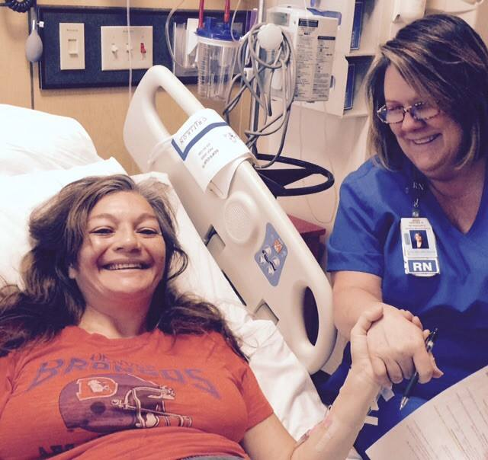
Thank You!
Our volunteers
Hospitals
Patients and their families
In-kind donors
Sponsors
Strategic partners
Operation Walk USA 2024: December 2-6 www.operationwalkusa.org

